Slide 1

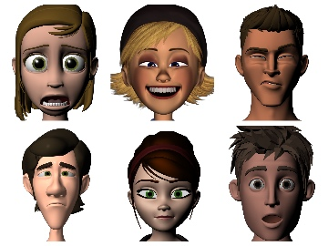

Emotion Classification of Animated Characters
Transfer Learning Performance Comparison
Katelyn Wang
Tracy Zhang

Slide 2
Executive Summary
Goal
Emotion Classification of Cartoon Characters of different style (anime vs. 3D cartoon)
Solution
- Transfer learning and fine-tuning
- Compare the accuracy of different pretrained models & baseline CNNs
Value
- Few studies explored this subject before => improve image search result quality
- Understand how neural networks differentiate emotions of fictional figures, whose characteristics vary dramatically between artists

Slide 3

Technical Challenges
Animated faces have different characteristics from real human faces
Limited availability of existing labeled data

Slide 4

Our Approach
Data augmentation
Benchmark: Vanilla CNN
Fine-tuning pretrained models
Early stopping
Batch Normalization
Dropout layers

Slide 5
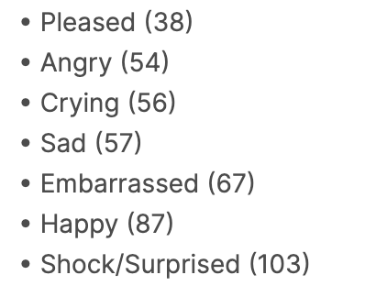
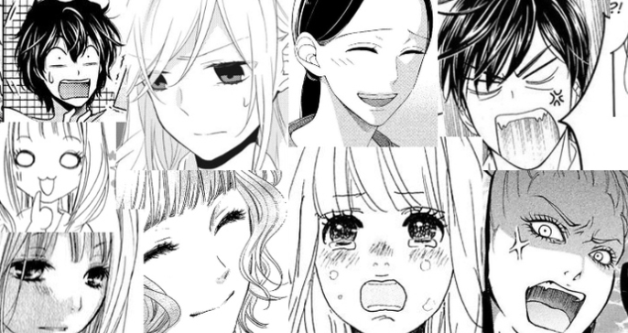
Implementation Details: Models and Data sets
Models
Data Sets
Facial Expression Research Group 2D Database (FERG-DB)
55767 annotated face images of 6 characters
Manga Facial Expressions Data Set (462 images)
GoogleNet
ResNet50, pretrained on ImageNet
Vanilla CNNs

Slide 6
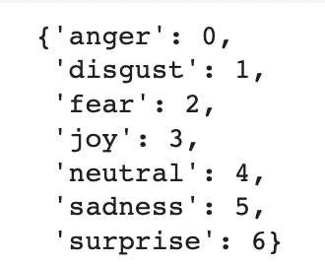
Shortage of the Dataset
Manga Facial Expressions Data Set (462 images)
Vague labeling
The labeling of the dataset is subjective
Facial Expression Research Group 2D Database (FERG-DB)
Limited Categories →
Limited Characters → could be “overfitting”
Similar in training and validation

Slide 7
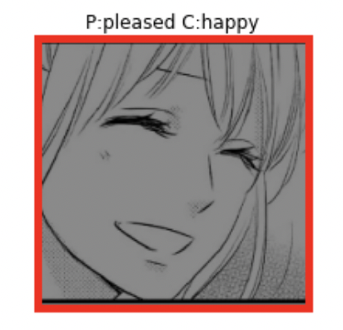
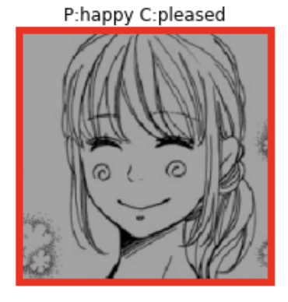

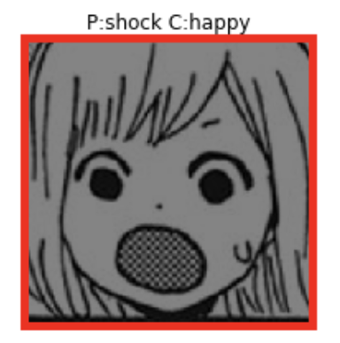

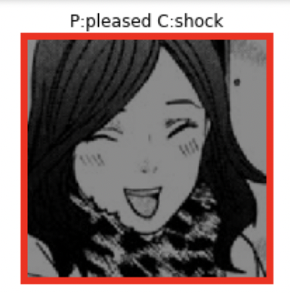
Experimental Evaluation - Analysis
Subjective labeling in training/validation data

Slide 8
Experimental Evaluation - Result
model | dataset | model details | avg val accuracy | max val accuracy | pred accuracy
CNN from scratch | manga | baseline | 0.3214 | 0.3835
CNN from scratch | manga | baseline + leakyRELU | 0.3155 | 0.411
CNN from scratch | manga | baseline + leakyRELU + Batch Norm | 0.2269 | 0.2877
CNN from scratch | ferg | baseline | 0.6815 | 0.7184
ResNet50 | manga | 1 Dense layer + sigmoid | 0.343 | 0.4167 | 0.31
ResNet50 | manga | 2 Dense 64 layer + leakyRELU + softmax | 0.364 | 0.3796 | 0.47
ResNet50 | ferg | baseline | 0.6241 | 0.5406
GoogleNet | manga | baseline | 0.33 | 0.47
GoogleNet | manga | baseline + Batch Norm + 2 Dense 64 Layer | 0.35 | 0.47
GoogleNet | manga | baseline+early stop | 0.27 | 0.37
GoogleNet | manga | L2 Regularization | 0.3 | 0.56
GoogleNet | manga | one more Inception on block 3 and 5 | 0.27 | 0.4
GoogleNet | ferg | baseline | 0.59 | 0.9
GoogleNet | ferg | baseline+ Batch Norm + 2 Dense 64 Layer |  | 0.459

Slide 9
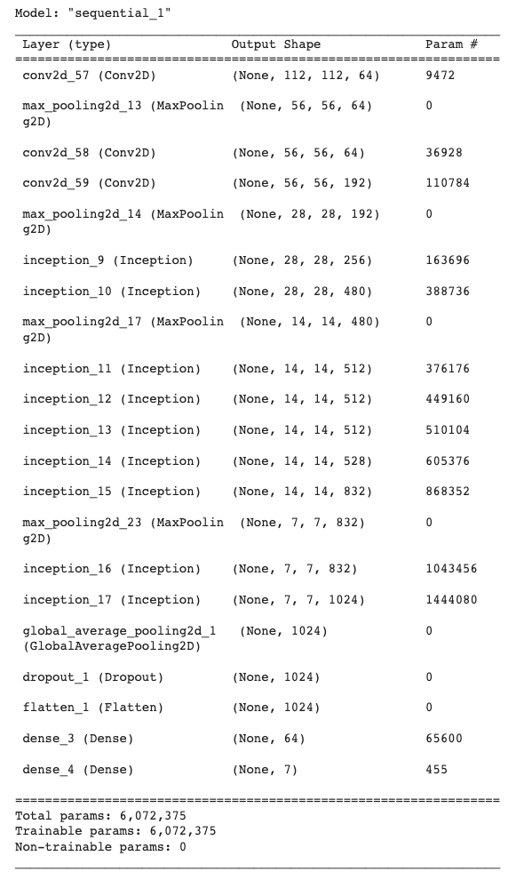
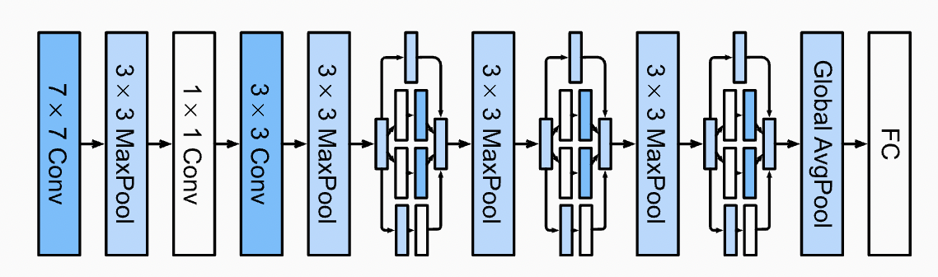
GoogleNet
2 *
5 *
2 *

Slide 10
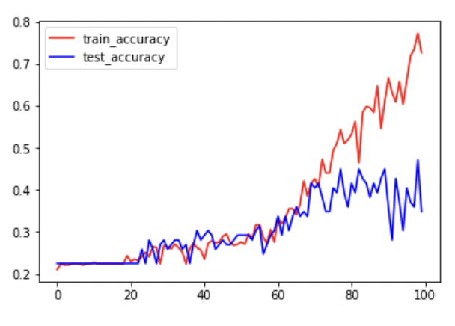
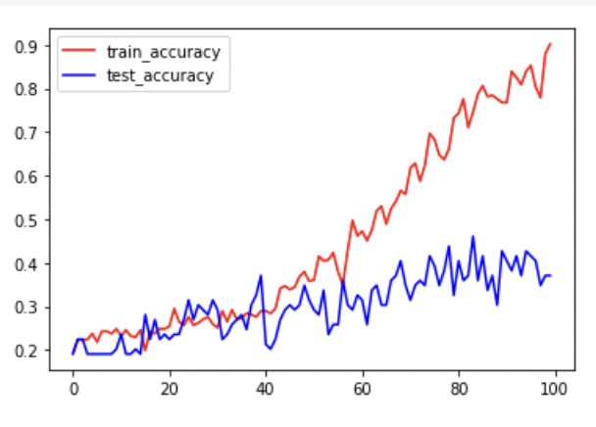
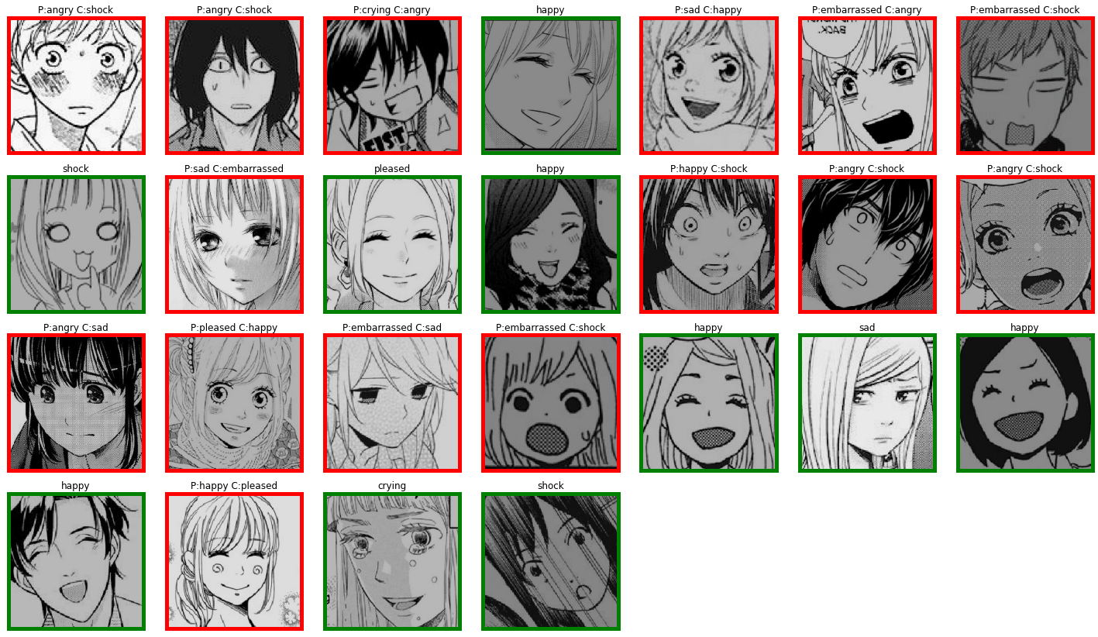
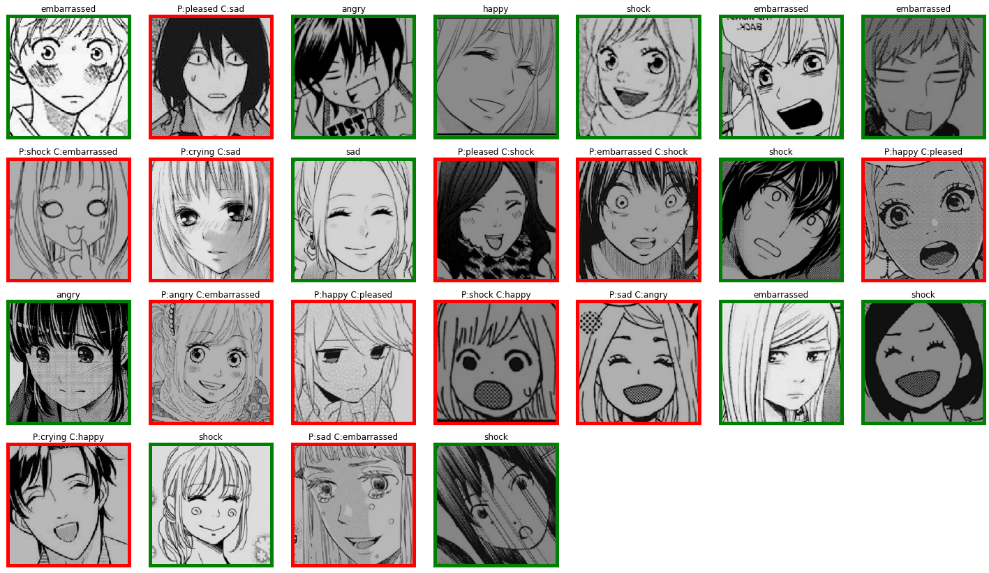
Comparison(Manga)
Baseline
baseline + Batch Norm + 2 Dense 64 Layer

Slide 11
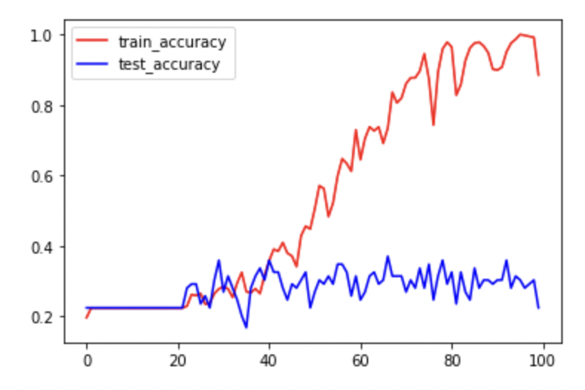
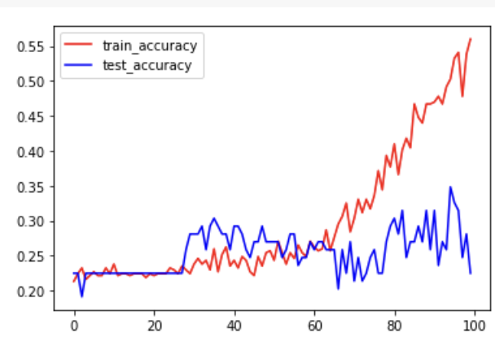
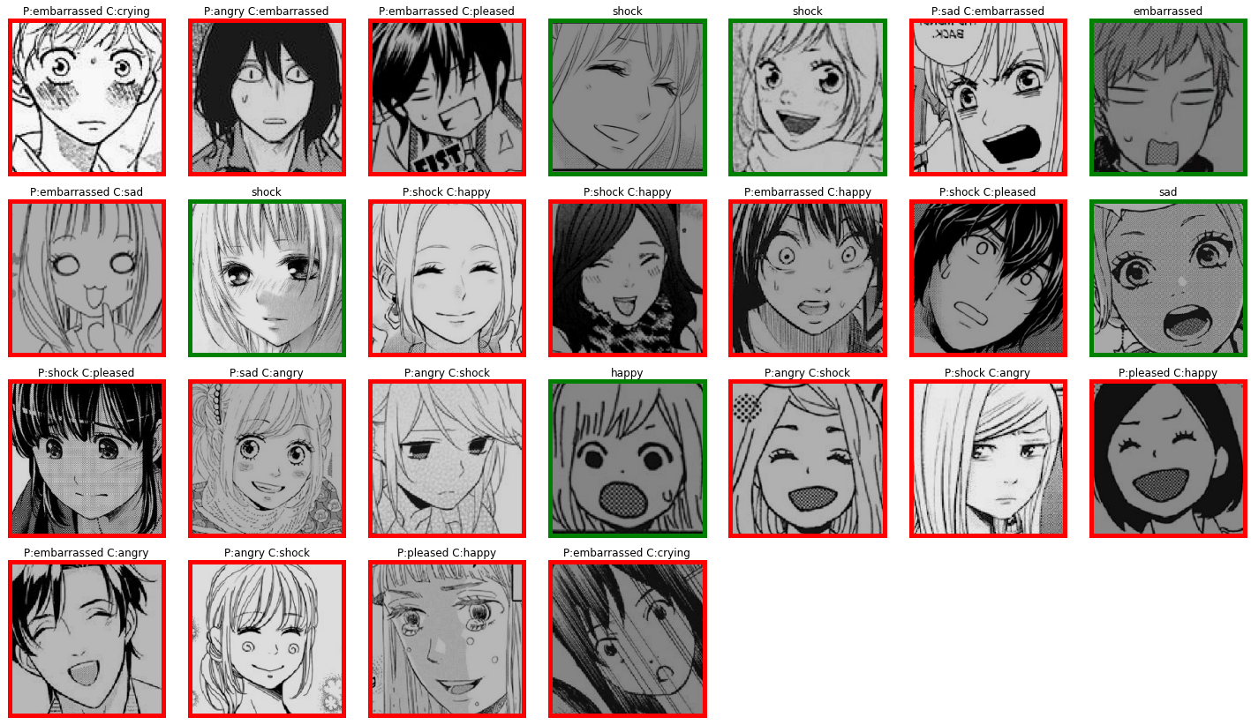
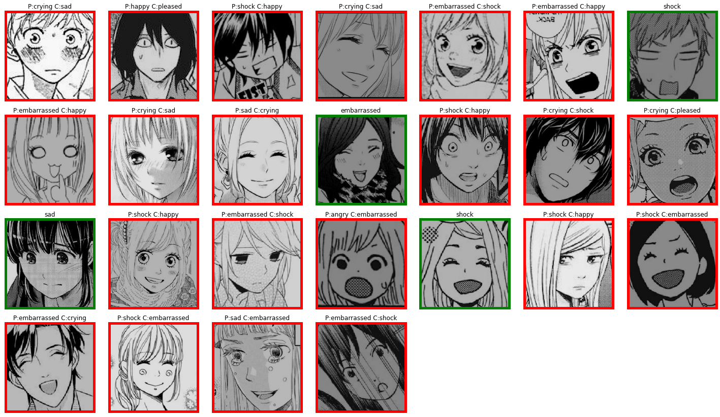
baseline+early stop
L2 Regularization

Slide 12
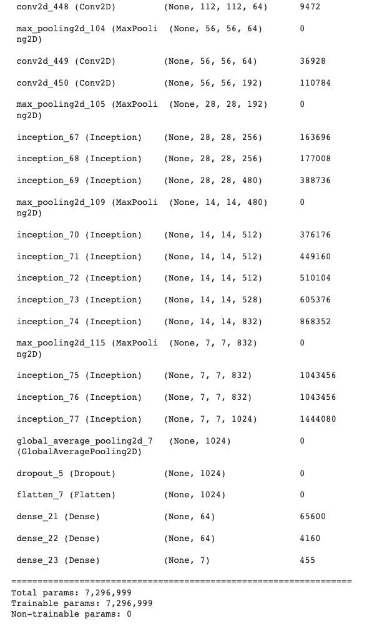
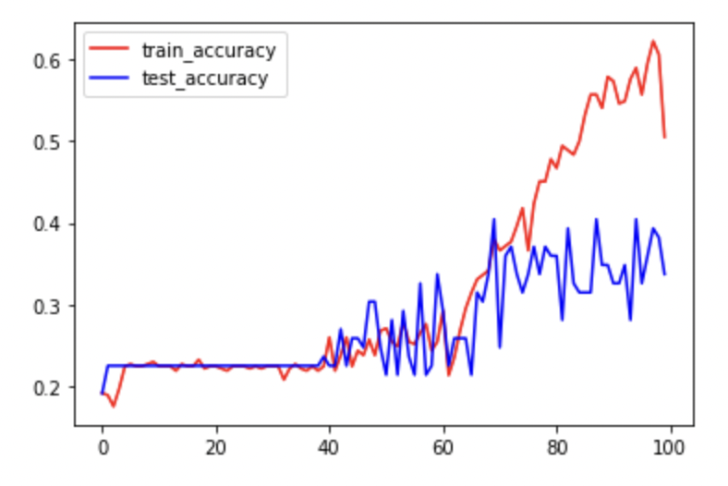
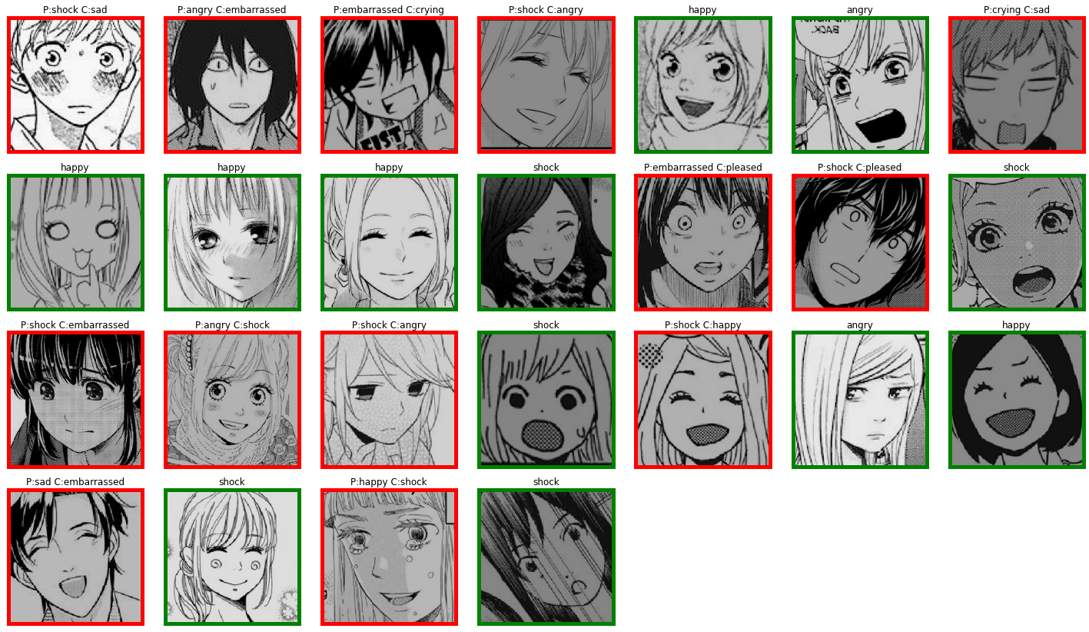
one more Inception on block 3 and 5

Slide 13
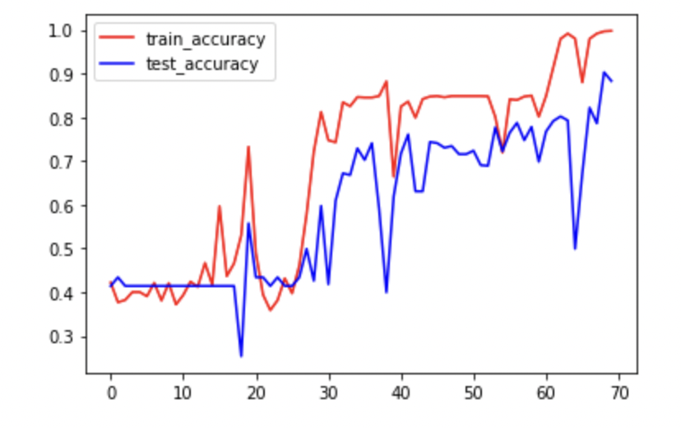
FERG
[it took me 5 hours to train GoogleNet with ]

Slide 14
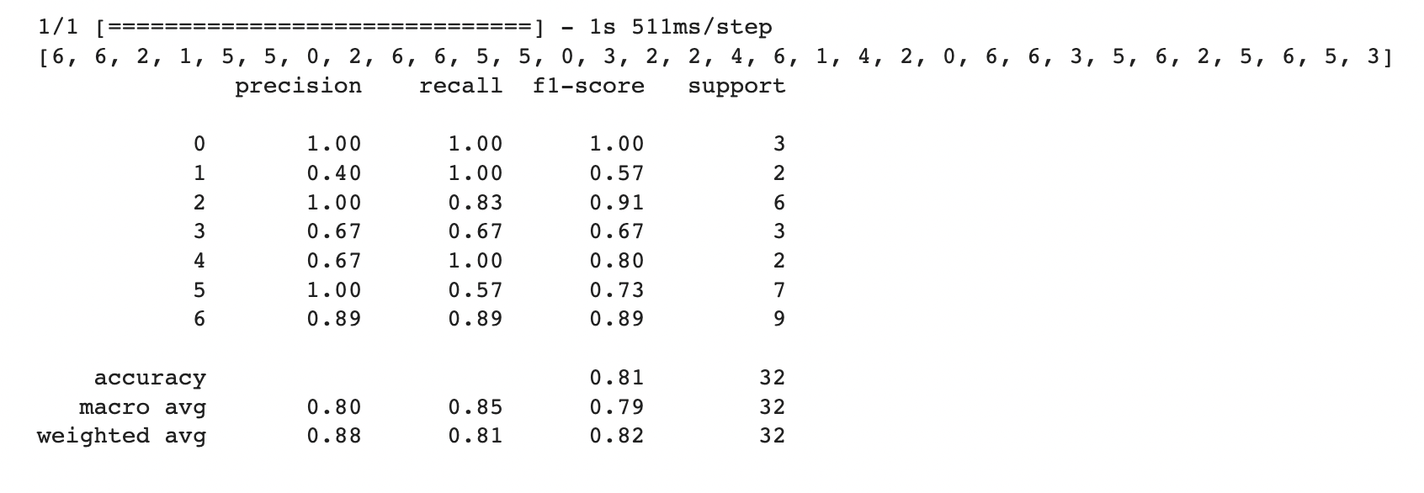
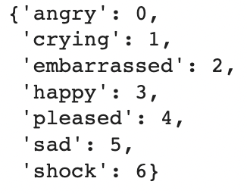
Conclusion
When the dataset is small
Changing the structure of the model is able to increase the accuracy and control overfitting, with mild effect on runtime
When the dataset is large:
GoogleNet is faster the baseline
Use ’val_categorical_accuracy’to evaluate accuracy
Overall top 3 performance:
L2 Regularization
baseline + Batch Norm + 2 Dense 64 Layer
baseline

Slide 15

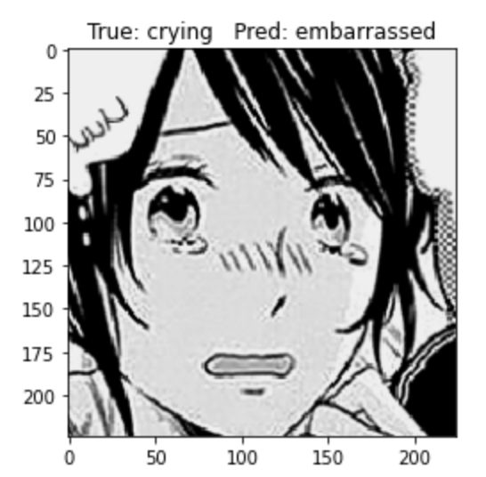
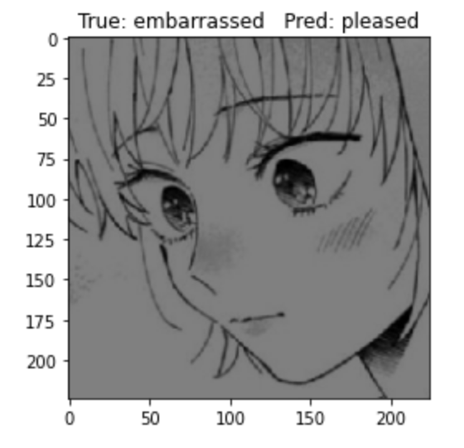
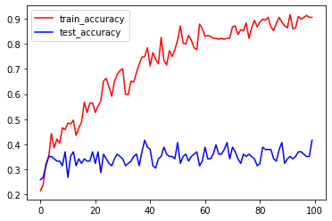
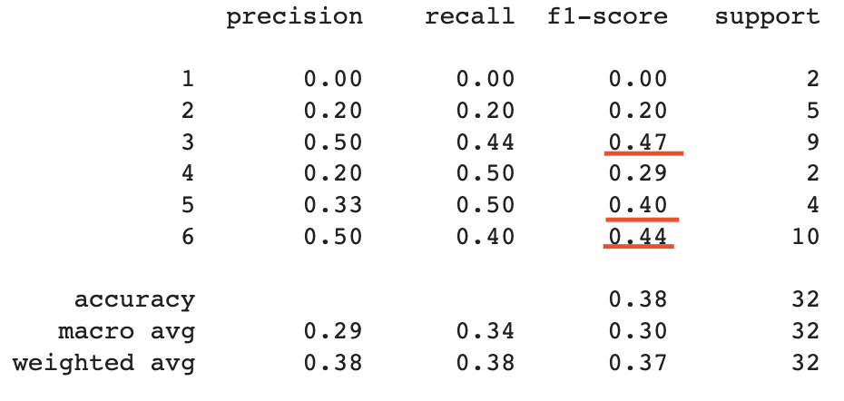
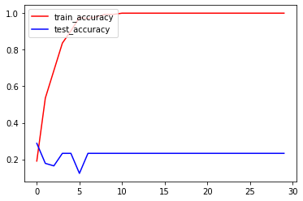
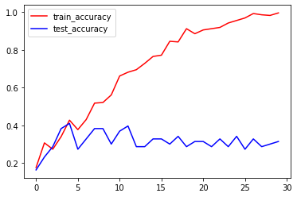
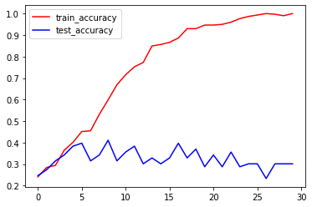
Manga
ResNet - RELU + sigmoid, single dense layer
Vanilla CNN
'happy'
'sad'
'shock'
Notes:
The highest accuracy for vanilla is 0.41 but it’s still overfitting

Slide 16
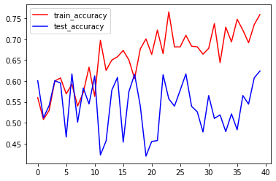
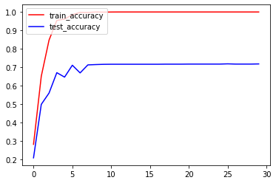
FERG
ResNet
Vanilla CNN
Notes:
ResNet: oscillating
Vainilla cnn: actually has very good performance => simplicity of the dataset makes it possible, doesn’t really need a very complicated network

Slide 17
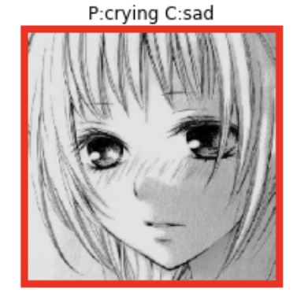
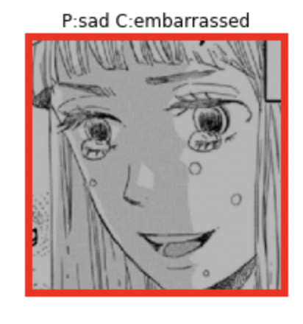


Fun Fact
Few shades below eyes → sad/crying
Wide open eyes → angry

Slide 18

Reference
http://grail.cs.washington.edu/projects/deepexpr/ferg-2d-db.html
https://ai.plainenglish.io/googlenet-inceptionv1-with-tensorflow-9e7f3a161e87
https://openaccess.thecvf.com/content_cvpr_2017/papers/Wu_A_Compact_DNN_CVPR_2017_paper.pdf
Szegedy, C., Liu, W., Jia, Y., Sermanet, P., Reed, S., Anguelov, D., … Rabinovich, A. (2015). Going deeper with convolutions. Proceedings of the IEEE conference on computer vision and pattern recognition (pp. 1–9).
Link to github

